Slide 1
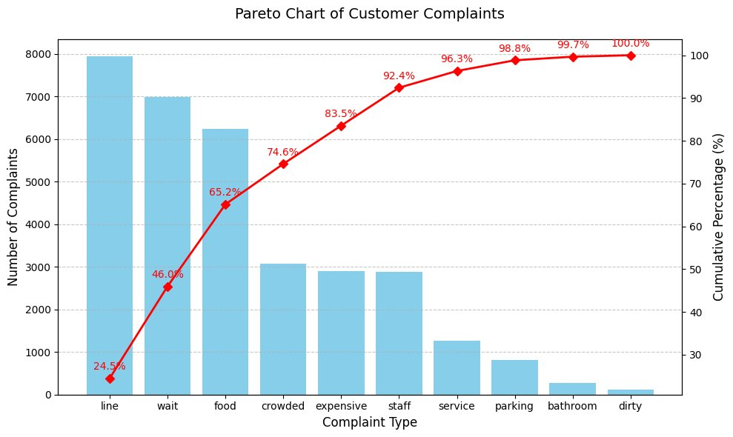

Top 10 Complaints
Line
Wait
Food
Crowded
Expensive
Staff
Service
Parking
Bathroom
Dirt
What are Wisneyland's most frequent complaints?

Slide 2
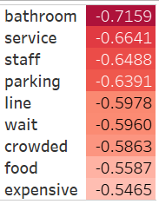
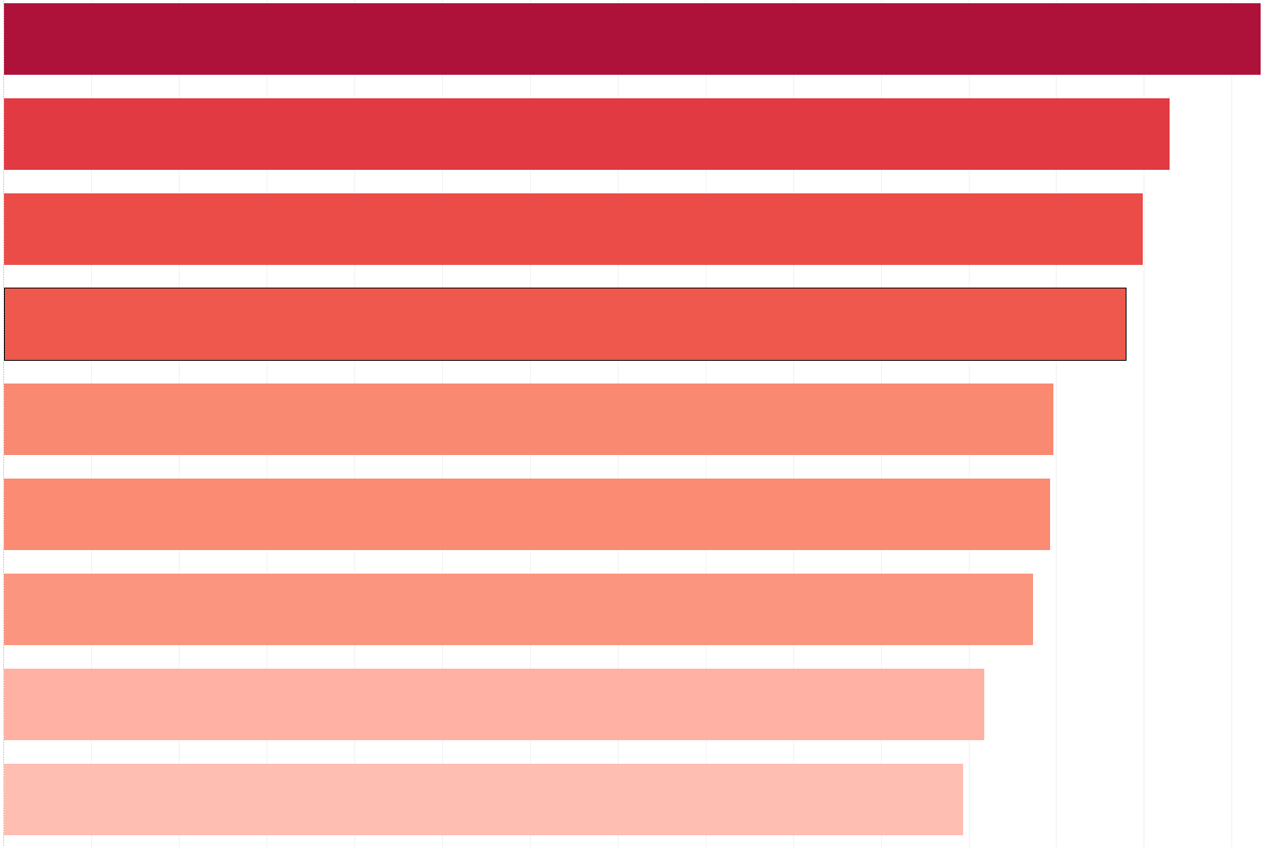
Negative Polarity Scores
What are angry customers specifically angry about?

Slide 3
Recommendations and Solutions
Most Common Complaints
Line
Wait
Food
Crowded
Most Negative Complaints
Bathroom
Service
Staff
Parking
Focus on Frequency or Severity?
All issues correlate with a need for additional service staff
Increase count of workers for peak periods.
Enhance customer service training with a focus on efficiency and friendliness.
Analyze customer feedback on platforms like social media, review sites, and internal surveys for specific elements like Ride, Bathroom, Food, and Parking Lines

